Slide 1

Amplify ETFs Strategies
HIGH INCOME | HIGH QUALITY
HCOW | DIVO
Amplify Cash Flow High Income ETF | Amplify CWP Enhanced Dividend Income ETF
IDVO | NDIV
Amplify International Enhanced Dividend Income ETF | Amplify Natural Resources Dividend Income ETF
YYY | SOF
Amplify High Income ETF | Amplify Samsung SOFR ETF
6
INCOME
44% of AUM
Over $9 billion in assets across 32 ETFs in three distinct disciplines addressing a range of opportunities & investor goals
RISK-MANAGED STRATEGIES & DIVERSIFICATION
AIEQ | IWIN
Amplify AI Powered Equity ETF | Amplify Inflation Fighter ETF
COWS | MVPS
Amplify Cash Flow Dividend Leaders ETF | Amplify Thematic All-Stars ETF
ETHO | QSWN
Amplify Etho Climate Leadership U.S. ETF | Amplify BlackSwan Tech & Treasury ETF
ISWN | SWAN
Amplify BlackSwan ISWN ETF | Amplify BlackSwan Growth & Treasury Core ETF
8
CORE
6% of AUM
TOP MARKET TRENDS & GROWTH INDUSTRIES
The New Digital Era Blockchain technology (BLOK) Cybersecurity (HACK) Digital payments (IPAY | EMFQ) Online shopping (IBUY) Cloud computing (IVES) Travel technology (AWAY) Innovative technology (ITEQ) | Growth Industries Precious Metals (SILJ) Shipping (BDRY | BWET) Weight Loss (THNR) Pharma (GERM) Decarbonization (BATT)
18
THEMATIC
50% of AUM
Data as of 5/21/24

Slide 2

Is it time to get THNR?
Amplify Weight Loss Drug & Treatment ETF

Slide 3

The Scale of the Problem
Worldwide obesity among the adult population has more than doubled since 1990.¹
43% of adults are now overweight or obese.¹
Obesity has far-reaching implications with a negative macroeconomic impact estimated to be 3.6% of U.S. GDP. ²
A potential $1.24 trillion in indirect costs from lost productivity.²
1 WHO, “One in eight people now living with obesity,” March 1, 2024, https://www.who.int/news/item/01-03-2024-one-in-eight-people- are-now-living-with-obesity. 2 Nic Sochovsky and Helena Miles, Morgan Stanley, “GLP-1: The Weight Speculation,” December 2023, https://www.morganstanley. com/im/publication/insights/ articles/article_geoglp1_us.pdf?1714161368409.

Slide 4
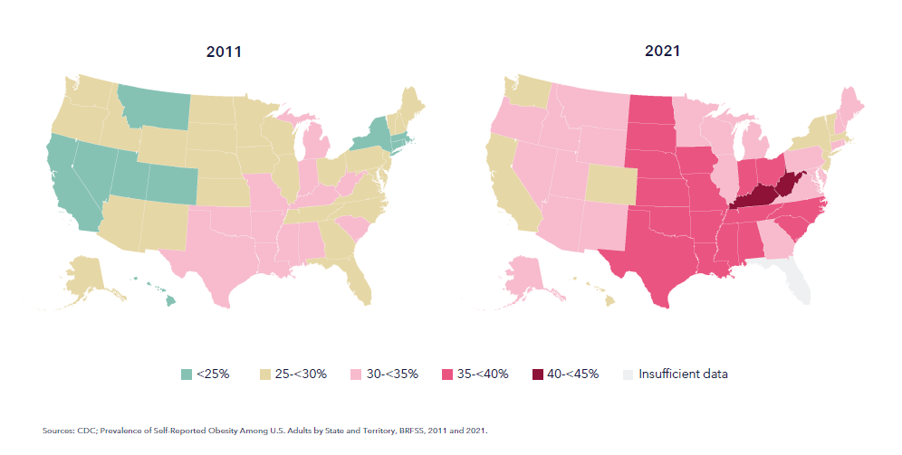
Obesity Growth in the U.S.
Prevalence of Obesity Among U.S. Adults by State 2011 vs 2021
42% of U.S. adults are obese.
Obesity rates continue to grow, even over the past decade.

Slide 5
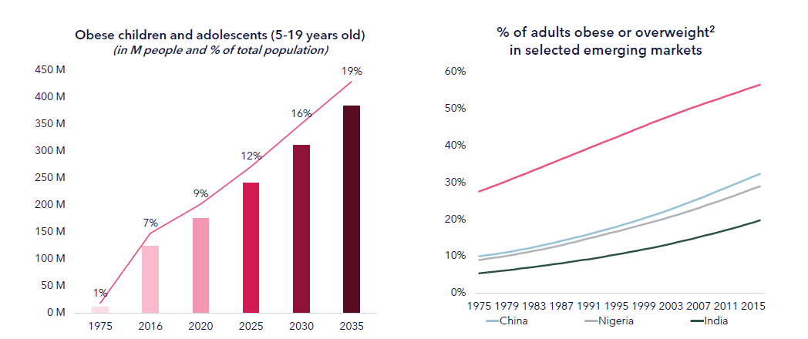
Worldwide Obesity Growth
Youth obesity rates are growing.
Obesity rates in China, India, and Nigeria are growing.
A staggering 43% of adults are now overweight or obese.¹
Source: LHS - NCD-RisC 2017, World Obesity Atlas March 2023, United Nations (UN) World Population Prospects 2022. RHS - Overweight defined as BMI greater than 25. Estimates are age-standardized and for both sexes ; source: ourworldindata.org.
1 WHO, “One in eight people now living with obesity,” March 1, 2024, https://www.who.int/news/item/01-03-2024-one-in-eight-people- are-now-living-with-obesity.

Slide 6
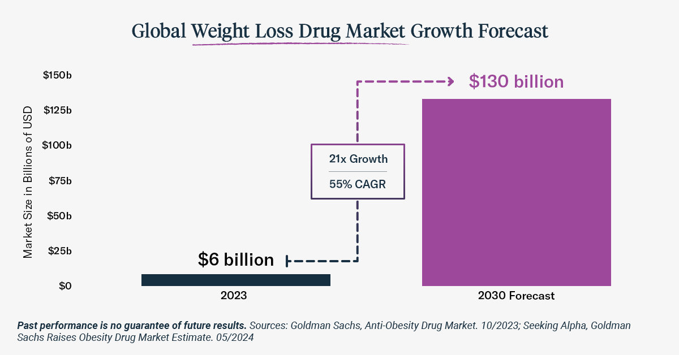
Weight Loss, Investors Gain
Recently, the global market for anti-obesity medications (AOMs) reached $6 billion on an annualized basis.
The Investment Opportunity Presented by Weight Loss Treatment Innovations
CAGR is the compound annual growth rate.
Remarkably, by 2030, it could grow by more than 21 times to $130B.
CAGR is the compound annual growth rate

Slide 7
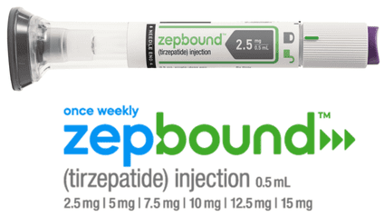
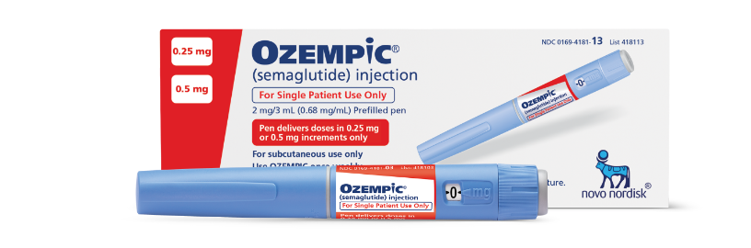
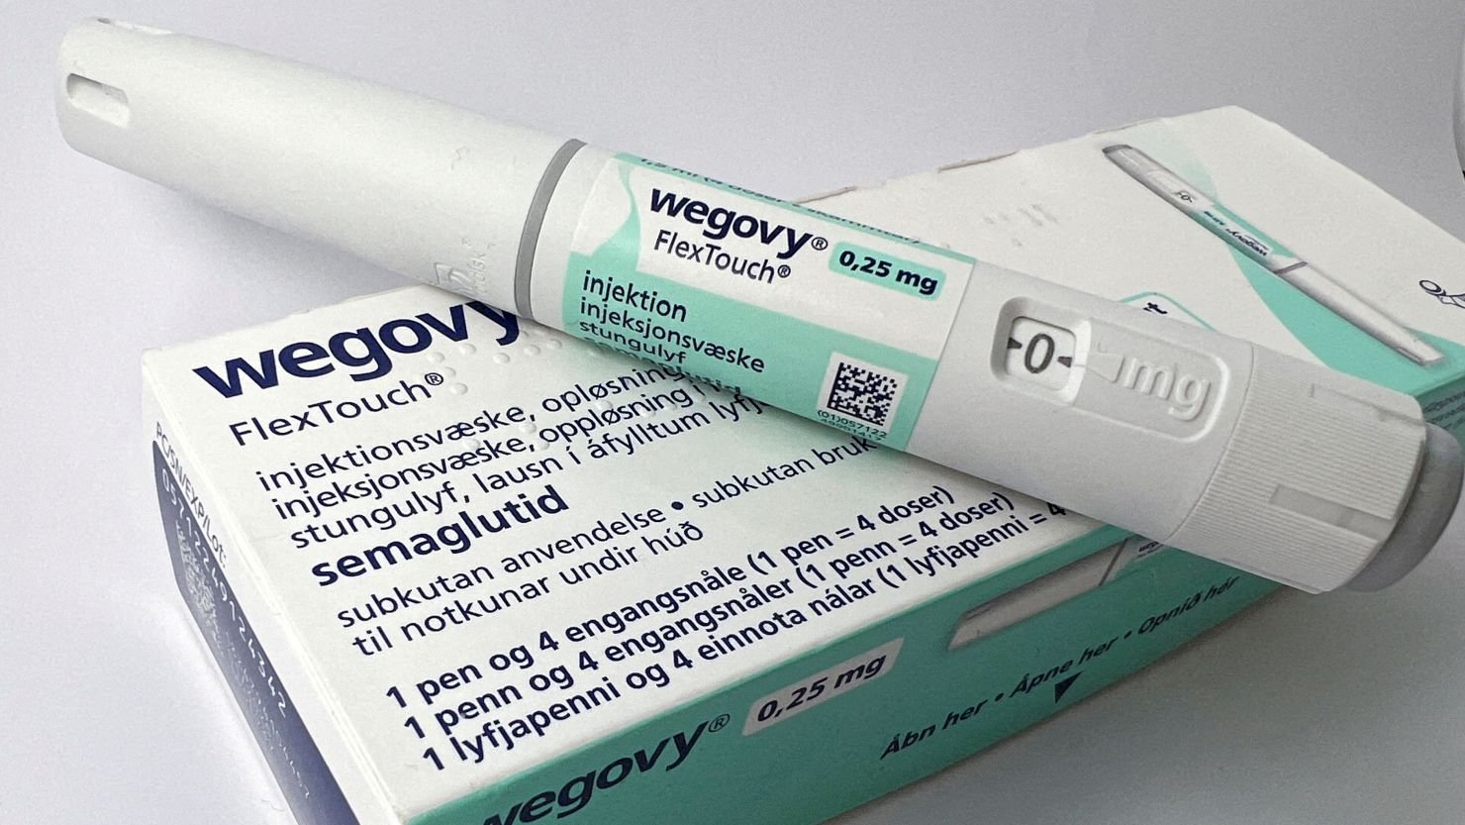
GLP-1s Weight Loss Medicines
For illustrative purposes only.

Slide 8
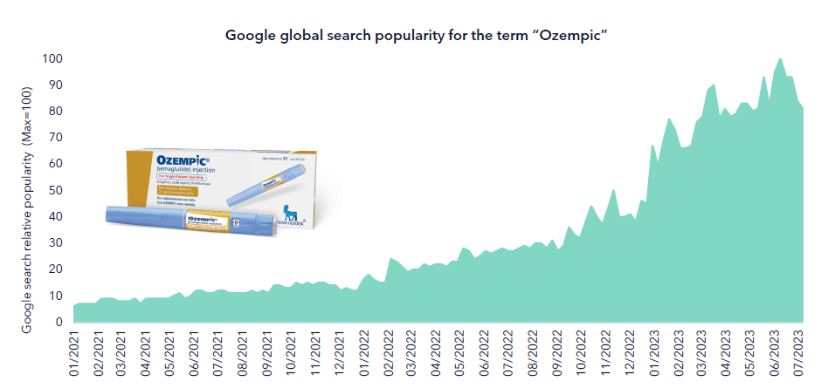
Demand Continues to Grow
Source: Google Search Trends for “Ozempic”, Worldwide ; 1STAT/Harris Poll survey “Obesity and Weight Loss Meds.: Attitudes and Interest”. Ozempic is an off-label use for obesity, which is FDA approved for Type II diabetes but not for obesity. A similar drug, high dose semaglutide, or Wegovy, was approved for obesity in 2021.

Slide 9
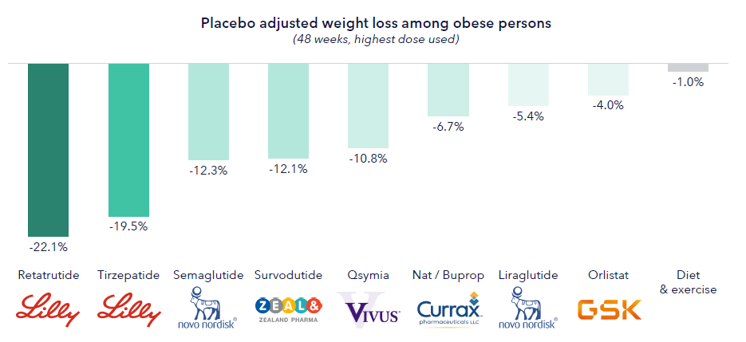
Weight Loss Innovation
Innovation in weight loss is accelerating producing drastic results, especially in combination agents
Stifel, healthcare, “Obesity drug review”, market update July 1st, 2023.

Slide 10




What is GLP-1?
Triggers insulin release from the pancreas: Insulin is an essential hormone that allows the body to use food to create energy. It lowers the amount of glucose (sugar) in the blood. If you do not have enough insulin, blood sugar increases, leading to diabetes.
Blocks glucagon secretion: Glucagon is a hormone the body uses to raise your blood sugar levels when necessary. GLP-1 prevents more glucose from going into the bloodstream.
Slows stomach emptying: Slower digestion means that the body releases less glucose (sugar) from the food you eat into the bloodstream.
Increases satiety (how full you feel after eating): GLP-1 affects areas of the brain that control hunger and satiety.
(Glucagon-Like-Peptide 1)
GLP-1 agonists work by mimicking the action of glucagon-like peptides which are naturally released by the intestines after eating food.
Cleveland Clinic, GLP-1 Agonists, https://my.clevelandclinic.org/health/ treatments/13901-glp-1-agonists.

Slide 11
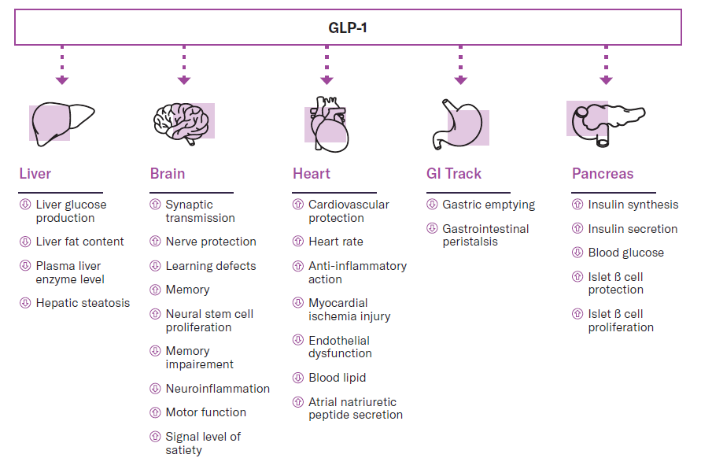
The GLP-1 Effect
GLP-1 has multiple biological effects beyond diabetes and weight loss.
Xin Zhao, Minghe Wang, et al, “GLP-1 Receptor Agonists: Beyond Their Pancreatic Effects,” Frontiers in Endocrinology, 2021, https://www.frontiersin.org/ journals/endocrinology/articles/10.3389/fendo.2021.721135.

Slide 12
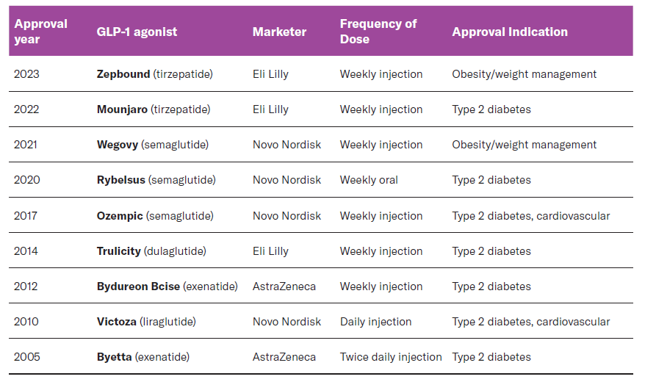
Today’s Generation
GLP-1 drugs date back to 2005, for use in Type-2 diabetes patients, with current formulations now being approved for obesity/weight loss management.
Notes:
There are currently several GLP-1 agonist drugs on the market that are generally taken by injection on a daily or weekly basis.

Slide 13
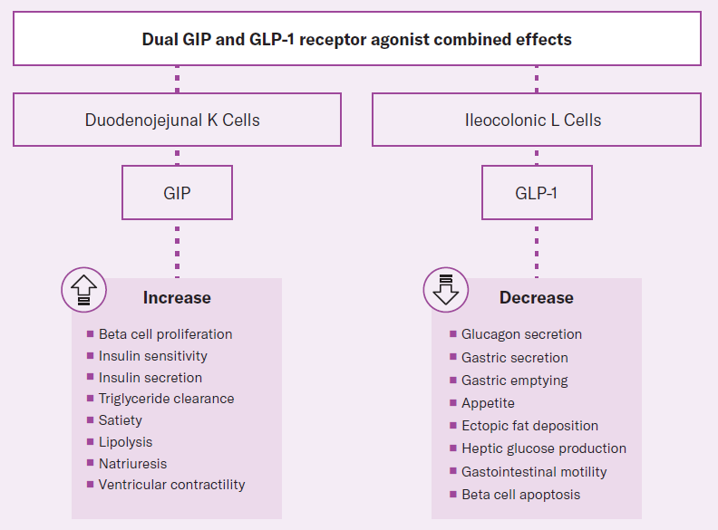
New Generation
GLP-1 and GIP are peptide hormones or incretins released by the gut in response to nutrients. This hormone pathway is a self-regulating feedback system connecting the gut with the brain, the pancreas, and the liver.
Source: Visual Alpha

Slide 14
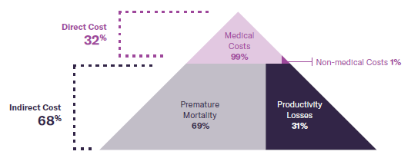
Weighing Economic Factors
New weight-loss drugs could boost GDP by 1% in the coming years by lowering obesity-related complications and boosting workplace efficiency*
*More Americans Taking Ozempic Could Boost US Economy Growth Outlook (businessinsider.com).
Source: World Obesity Federation and RTI International “The Economic Impact of Overweight & Obesity in 2020 and 2060”, 2022

Slide 15

Safety and Efficacy
In 2023, data from the largest clinical trial of GLP-1’s to date, the SELECT trial of nearly 18,000 non-diabetic participants showed evidence of reduced heart attacks, strokes, and deaths due to cardiovascular disease; and 73% of patients did not progress to diabetes. Subjects also saw a 19% reduction in all causes of morbidity and a 20% reduction in major adverse cardiac events.
The SELECT trial showed approximately a 19% reduction in all causes of morbidity.
https://www.cnbc.com/2023/11/11/weight-loss-drug-wegovy-slashes-risk-of-serious-heart-complications.html.

Slide 16
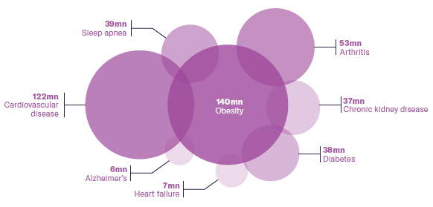
Beyond the Scale
Ongoing GLP-1 drug research shows promise for other conditions & uses including addiction, alcohol use disorder, Parkinson’s, non-alcoholic fatty liver disease, PCOS, Alzheimer’s, and colon cancer.
Source: Alzheimer’s Association, American Diabetes Association, American Heart Association, Centers for Disease Control and Prevention, Journal of Cardiac Failure, National Council on Aging, National Institute of Diabetes & Digestive & Kidney Diseases, World Obesity Federation; as of January 2024

Slide 17
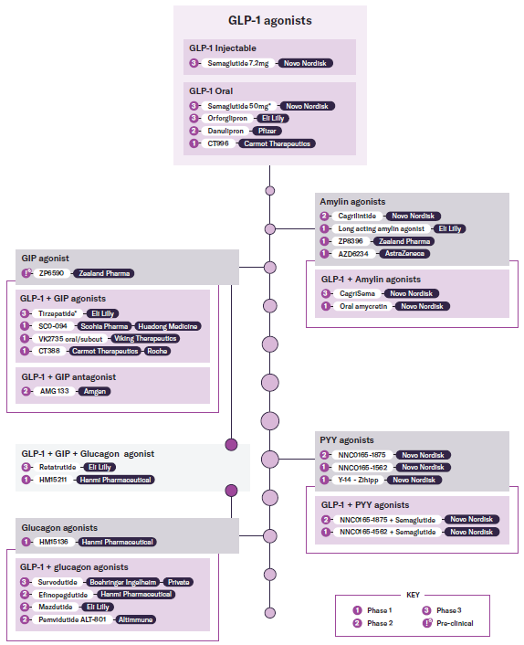
GLP-1 Pipeline
Two companies, Novo Nordisk and Eli Lilly, accounted for 98% of the revenues derived from GLP-1 drugs in 2023, generating $37.3 billion of the $37.9 billion of revenues, but there are many new drugs in the pipeline including oral forms and forms with less side effects.
Source: International Journal of Obesity

Slide 18
THINR
Index
Starting Universe: Global investable universe
Minimum Market Cap of $500,000,000
Minimum 3-month Avg. Daily Trading Volume of 1,000,000
2 Segments: GLP-1 Drug Manufacturers and Enablers
Drug Manufacturers:
Companies that have GLP-1 Agonist Drugs that are either launched or in FDA clinical trials (i.e., Eli Lilly and Novo Nordisk)
Total weight in index 70%, float market cap weighted within segment
Companies with Drugs in phase 2 or below max weight 5%
Companies with commercial or phase 3 max weight 15%
Enablers:
Companies involved with the outsourced development and manufacturing of GLP-1 Agonist Drugs (i.e., Catalent). Includes companies conducting measurement and analysis of said drugs (i.e., Thermo Fisher). Typically, these are contract development and manufacturing organizations (CDMOs).
Total weight in index 30%, float market cap weighted within segment
Max weight 5%
The sum of weights > 5% must be less than or equal to 45% of the total index. Capped weights are redistributed within segment to ensure total weights are equal to set amounts.
VettaFi Weight Loss Drug & Treatment Index

Slide 19
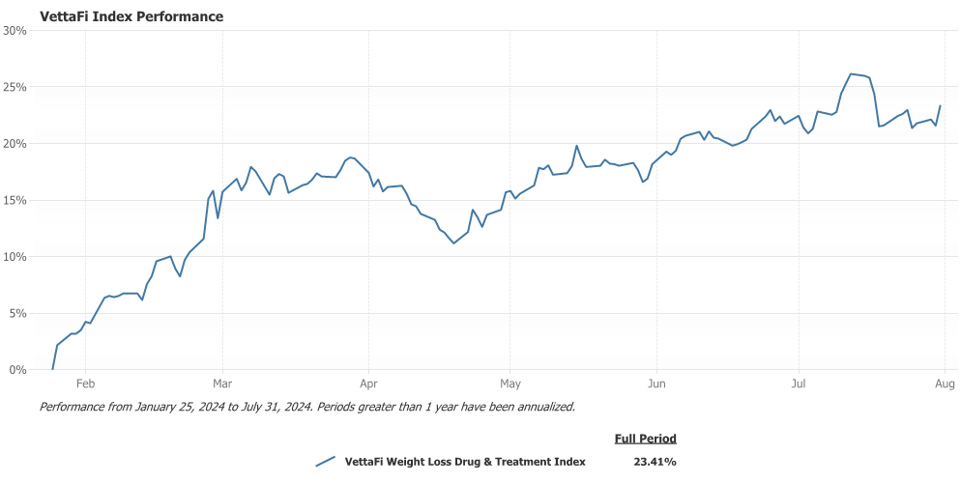
VettaFi Weight Loss Drug & Treatment Index
THINR
Index
Since Inception
Past performance does not guarantee future results. Indexes are unmanaged and it is not possible to invest directly in an index. The VettaFi Weight Loss Drug & Treatment Index is a float-adjusted market cap weighted index comprised of global companies who are manufacturers or enablers of the GLP-1 pharmaceutical business.

Slide 20
Ticker | Name | HQ | Industry Group | Category | Details | Index Weight
LLY | Eli Lilly & Co. | US | Biopharma | Manufacturers | FDA approved drug Zepbound for chronic weight management, a higher dose version of diabetes drug Mounjaro | 15.31%
NVO | Novo Nordisk A/S | DK | Biopharma | Manufacturers | FDA approved drug Wegovy for weight loss, a higher dose version of Ozempic | 14.37%
AZN | AstraZeneca PLC | GB | Biopharma | Manufacturers | Acquired Eccogene's GLP-1 drug for the treatment of obesity, type-2 diabetes, and cardiovascular conditions - phase 1 | 7.18%
AMGN | Amgen Inc. | US | Biopharma | Manufacturers | Amgen's most advanced experimental candidate (Phase 2) activates GLP-1 while blocking GIP. It says its goal is quicker weight loss, less frequent dosing and possibly better weight maintenance. | 5.21%
PFE | Pfizer Inc. | US | Biopharma | Manufacturers | Has oral GLP1 drug in pipeline (danupipron) in phase 2 | 5.04%
ROG | Roche Holdings AG | CH | Biopharma | Manufacturers | Carmot Therapeutics GLP1 drug in phase 1 | 5.03%
MRK | Merck & Co., Inc | US | Biopharma | Manufacturers | Merck's experimental drug efinopegdutide, which belongs to the GLP-1 class and is being developed as a treatment for non-alcoholic steatohepatitis (NASH), also showed a "compelling" weight-loss benefit. | 4.76%
ZEAL | Zealand Pharma As | DK | Biopharma | Manufacturers | Zealand has an approved GIP drug and amlyn agonist in phase 1 | 2.92%
4188 | Mitsubishi Chemical Group Corp. | JP | Chemicals | Manufacturers | Eli Lilly Japan and Mitsubishi Tanabe Pharma Corporation signed a sales collaboration agreement in Japan for GIP/GLP-1 receptor agonist “Tirzepatide” | 2.88%
1801 | Innovent Biologics Inc. | CN | Biopharma | Manufacturers | Mazdutide is the first GLP-1R/GCGR dual agonist to successfully complete Phase 3 trials in support of a NDA submission | 2.74%
VKTX | Viking Therapeutics Inc. | US | Biopharma | Manufacturers | Oral/subcut drugs in phase 1 | 2.22%
GPCR | Structure Therapeutics Inc | CN | Biopharma | Manufacturers | Oral GLP-1 drug in phase 2 | 2.01%
128940 | Hanmi Pharmaceutical Co Ltd | KR | Biopharma | Manufacturers | Glucagon agonists and combo therapy in phase 1 (Efinopegdutide Phase 2 and JM15136 in Phase 1) | 0.51%
ALT | Altimmune Inc. | US | Biopharma | Manufacturers | Phase 2 drug Pemvidutide ALT-801 | 0.19%
OPK | OPKO Health, Inc. | US | Biopharma | Manufacturers | OPKO Health’s Oxyntomodulin, OPK88003, Shows Significant Reduction in HbA1c and Body Weight in Patients with Type 2 Diabetes in Phase 2 | 0.17%
GUBRA | Gubra A/S | DK | Healthcare Equipment & Services | Enabler | Partnered programs and drug discovery for GLP-1 | 0.09%
4519 | Chugai Pharmaceutical Co Ltd. | JP | Biopharma | Enablers | In agreement with LLY for oral GLP-1 royalty | 5.17%
4901 | FUJIFILM Holdings Corp. | JP | Technology Hardware & Equipment | Enablers | Novo hired hired FUJIFILM Diosynth Biotechnologies to fill Wegovy injection pens, also testing via Wako Chemicals | 4.97%
WST | West Pharmaceutical Services Incorporated | US | Healthcare Equipment & Services | Enablers | Contract-manufacturer for GLP1 drug injection, recent BofA upgrade on GLP1 demand | 4.88%
TMO | Thermo Fisher Scientific Inc | US | Healthcare Equipment & Services | Enablers | Novo hired Thermo Fisher as a contract manufacturer for Wegovy injection pens, along with Catalent | 4.81%
MRK | Merck KGaA | DE | Biopharma | Enablers | Merck KGaA's MilliporeSigma division provides life science research for GLP1 drugs | 4.45%
CTLT | Catalent Inc | US | Biopharma | Enablers | Novo aquiring contract drug manufacturer to expand its GLP1 production capabilities. Catalent, a contract development and manufacturing organization (CDMO), has been involved in the production of Wegovy. | 2.31%
GXI | Gerresheimer AG | DE | Healthcare Equipment & Services | Enablers | German packaging and medical equipment maker Gerresheimer is contracted to supply the two key players in the market for GLP-1 weight loss drugs with injector pens | 0.79%
HIMS | Hims & Hers Health Inc | US | Healthcare Equipment & Services | Enablers | Direct-to-consumer compounding pharmacy for GLP-1 drugs | 0.71%
BANB | Bachem Holding AG | CH | Biopharma | Enablers | Bachem's Liraglutide is a high-purity generic for diabets and weight loss | 0.68%
YPSN | Ypsomed Holding AG | CH | Healthcare Equipment & Services | Enablers | In September 2023, Ypsomed struck a deal to manufacture GLP-1 autoinjectors (such as Wegovy and Ozempic) for Novo Nordisk. Ypsomed expects to begin delivering the devices in 2025. | 0.38%
3933 | United Laboratories International Holdings | CN | Biopharma | Enablers | Biosimilar semaglutide | 0.24%
THINR
Index
VettaFi Weight Loss
Drug & Treatment Index
27 Current Holdings
15 Drug Manufacturers
12 Enablers
Index holdings as of 6/28/24 and are subject to change at any time and should not be considered recommendations to buy or sell any security.

Slide 21
Summary & Conclusion
Obesity is a Growing Global Problem: One-eighth of the global population is living with obesity. Beyond the mental and physical toll obesity poses at the individual level, it has a negative macroeconomic impact on the global economy due to negative health impacts and lost productivity.
GLP-1 is Spurring a Diet Drug Revolution: GLP-1 drugs are proving to be a breakthrough treatment for weight loss, promoting reductions in body weight by 10-20% and reducing consumption volumes by as much as 50%.
GLP-1 Drugs May Have Therapeutic Indications Beyond Diabetes and Weight Loss: In a recent landmark study, GLP-1 drugs were found to reduce the incidence of cardiac events and stroke by 20% in non-diabetic patients. But beyond cardiovascular disease, research is being conducted to explore its effectiveness as a treatment for many other medical conditions as well.
GLP-1 Drugs are a Disruptive Economic Force: GLP-1 drugs are expected to disrupt not just health care but many other sectors and industries, and investment research firms estimate the market for GLP-1 drugs will grow to $100 billion by 2030. By promoting healthier living and boosting productivity, these new drugs hold the potential to increase U.S. GDP levels by as much as 1% in the coming years.

Slide 22
THNR
Amplify Weight Loss Drug &Treatment ETF

Slide 23
THNR Overview
Fund Facts
Ticker | THNR
Inception | 5/21/2024
Primary Exchange | NYSE Arca
Number of Holdings (as of 6/30/24) | 27
Expense Ratio | 0.59%
Amplify Weight Loss Drugs & Treatment ETF (THNR) provides access to global companies involved in the pharmaceutical manufacturing of GLP-1 agonist or enablers of such businesses. THNR seeks investment results that generally correspond to the performance (before fees and expenses) of the VettaFi Weight Loss Drug & Treatment Index.
Why Invest in THNR?
Significant Growth Opportunity: The GLP-1 drug market is anticipated to grow from $6 billion to $130 billion by 2030.¹
Increasing Demand: Pharmaceutical companies are accelerating production to meet demand as over 42% of U.S. adults and 1 billion people worldwide are obese.²
Diversified Access: A global equity portfolio of companies pioneering GLP-1 therapies and the broader supply chain to capitalize on demand.
Index Details
Index Name/Ticker | VettaFi Weight Loss Drug & Treatment Index (THINR)
Index Provider | VettaFi
Weighting Methodology | Float-Adjusted Market Cap
Rebalance Frequency | Quarterly
1 Seeking Alpha, Goldman Sachs raises obesity drug market estimate to $130B. 5/30/2024. 2 World Health Organization, One in Eight People Are Now Living with Obesity, 03/2024. Pew Research Center, As Obesity Rates Rise in the US and Worldwide, New Weight Loss Drugs Surge in Popularity, 03/2024.

Slide 24
THNR Portfolio Allocation
THEMATIC ALLOCATION (as of 6/30/2024)
TOP 10 HOLDINGS (as of 6/30/2024)
Ticker | Company | Weight %
LLY | Eli Lilly & Co | 15.12%
NOVOB DC | Novo Nordisk A/S | 14.24%
AZN LN | AstraZeneca PLC | 7.12%
AMGN | Amgen Inc | 5.20%
4901 JP | FUJIFILM Holdings Corp | 4.95%
WST | West Pharmaceutical | 4.87%
TMO | Thermo Fisher Scientific | 4.80%
4519 JP | Chugai Pharmaceutical | 4.67%
PFE | Pfizer Inc | 4.65%
ROG SW | Roche Holding | 4.61%
COUNTRY ALLOCATION (as of 6/30/2024)
MARKET CAPITALIZATION (as of 6/30/2024)
Fund holdings are subject to change at any time and should not be considered recommendations to buy or sell any security.

Slide 25
THNR Performance
Daily NAV Performance
Performance
 | 1 Mo. | Since Inception (5/21/24)
Month end as of July 31st, 2024
Fund NAV | 1.33% | 4.49%
Closing Price | 1.03% | 4.47%
Quarter end as of June 30th, 2024
Fund NAV | 2.89% | 3.12%
Closing Price | 2.91% | 3.41%
The performance data quoted represents past performance. Past performance does not guarantee future results. The investment return and principal value of an investment will fluctuate so that an investor's shares, when sold or redeemed, may be worth more or less than their original cost and current performance may be lower or higher than the performance quoted. Short-term performance, in particular, is not a good indication of the fund’s future performance, and an investment should not be made based solely on returns. Brokerage commissions will reduce returns. A fund’s NAV is the sum of all its assets less any liabilities, divided by the number of shares outstanding. The closing price or market price is the most recent price at which the fund was traded.

Slide 26

Amplify ETFs

Slide 27

Carefully consider the Fund’s investment objectives, risks, charges, and expenses before investing. This and other information can be found in the Fund’s statutory and summary prospectuses, which may be obtained at AmplifyETFs.com. Read the prospectus carefully before investing.
Investing involves risk, including the possible loss of principal. There can be no assurance that the Fund’s investment objectives will be achieved. The fund is new with limited operating history. Shares of any ETF are bought and sold at market price (not NAV), may trade at a discount or premium to NAV and are not individually redeemed from the Fund. The Fund invests in securities included in its Index regardless of their investment merit and may experience tracking error: the differences in timing of trades, valuation, plus fees and expenses between fund and index.
A non-diversified fund and can invest a greater portion of its assets in securities of individual issuers which could cause greater fluctuations than a diversified fund. A narrowly focused portfolio concentrated in the pharmaceutical industry or healthcare sector, may exhibit higher volatility and be vulnerable to factors affecting them due to regulation, litigation, costs and competition.
Health care companies are subject to extensive government regulation and their profitability can be significantly affected by restrictions on government reimbursement for medical expenses, rising costs and pricing pressure. Health care and pharmaceutical companies are heavily dependent on obtaining and defending patents, which may be time consuming and costly, and the expiration of patents may also adversely affect the profitability of the companies. These companies are also subject to extensive litigation based on product liability and similar claims. In addition, their products can become obsolete due to industry innovation, changes in technologies, competition or other market developments.
Small and/or mid-capitalization companies may be more vulnerable to adverse general market or economic developments. Securities issued by foreign companies present risks beyond those of securities of U.S. issuers.
Amplify Investments LLC serves as the investment adviser to the Fund. Penserra Capital Management LLC serves as investment sub-adviser to the Fund. Amplify ETFs are distributed by Foreside Fund Services, LLC.
Questions?
Visit: AmplifyETFs.com
Phone: (855) 267 3837
Email: info@amplifyetfs.com
Connect with us:

